Slide 1
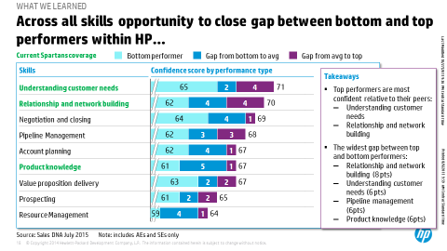
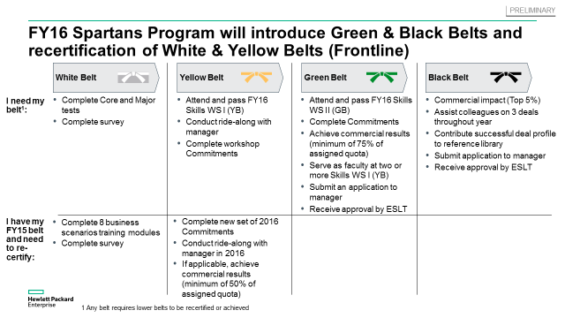
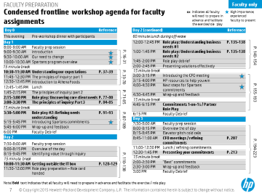
We instituted a comprehensive capability building and culture change program that is driving commercial results
TMT | Global
HIT016
ENGAGEMENT MODELS: FRONTLINE CAPABILITY BUILDING
Client context
Approach
Impact
Complex B2B solution selling organization, but…
…salesforce lacked understanding of how to engage customers effectively…
In the habit of selling “point” solutions
Spent more time advocating existing offerings than using inquiry to understand customer needs
… leading to declining pipeline and bottom line results
Organization-wide participation
7,000+ participants completed online product knowledge modules
2,200+ attended 3-day skills workshops hosted across the globe
850+ completed post-workshop Commitments
Real commercial results Those completing program:
Were 2x more likely to grow early stage pipeline
Closed deals directly attributed to the program worth ~$60M realized in FY15, which is impressive given long selling cycles and a mid-year kick-off
Sales DNA survey to identify which skills to feature in capability building workshops
Frontline program with multiple attainment levels and field Commitments
to drive commercial impact beyond the classroom
3 day practitioner-led workshops to teach skills using scenario-based role plays that “make it real” for sales participants
Client name: X
Team set-up: X
Fees Structure: X
What was unique: X

